Slide 1
Jackpot model Pricing
INNA WILLIAMS, JUNE 2, 2019

Slide 2
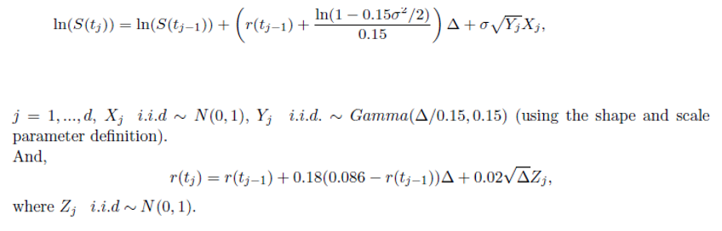
Jackpot Model Pricing

Slide 3
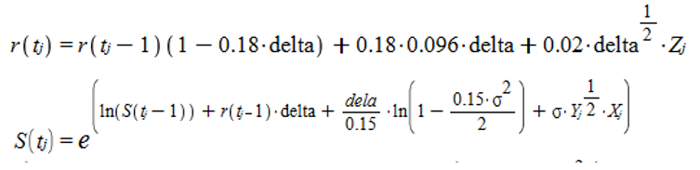
Implementation
Code implemented using the reference class with member variables and with class methods. When object of this class is created the method initialize is called automatically. All the required constant variables initialized in this function. All the variables that are member variables also initialized when the Constructor is called and the object of the Jackpot class is created.
The formulas will be used in the following way:

Slide 4

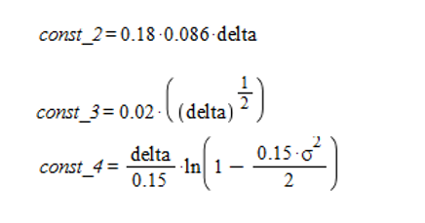

Methods
initialize()
Code constants come from the formulas:
init()
This method initializes required matrices, such as Z_{j}, Y_{j}, X_{j} , X_{j} for the constant rate and constant sigma and calculates the following:
It also initializes S_Maturity,rate_at_maturity and Discounted_payoffs

Slide 5
Methods (contd.)
r(): Calculate matrix r used in the above modified formula. Also calculates any annualized interest rate for the fair price.
s(): Calculates the sample path
Run():
Call other methods and calculates Jackpot call option price
Calculates sample size
Calculates estimated error for the calculated sample size
Calls Method to Calculate Estimated Euro Call Fair Price
Calls Method to Calculate Variance reduction method
s_t_rate_sigma_const(): Calculates sample path for constant rate and constant volatility
Run_For_Const_RATE_SIGMA(): Calculates European call option with a constant interest rate of r = 0.07 (and constant volatility of 13% for the jackpot model)
Calculate_Estimated_Euro_Call_Fair_Price(): Calculates estimated fair price of the European call option
GeometricMeanAsianControlVariate(): Calculates variance reduction method using Geometric Mean Asian as Control Variant
DisplayOutput()
DisplayControlVarOutput()

Slide 6

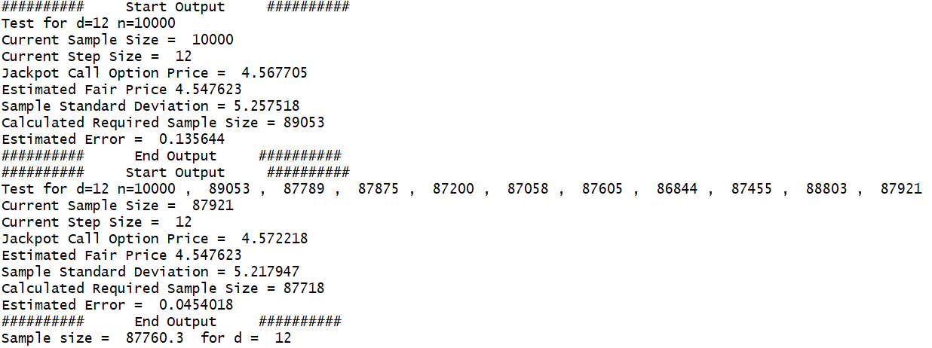
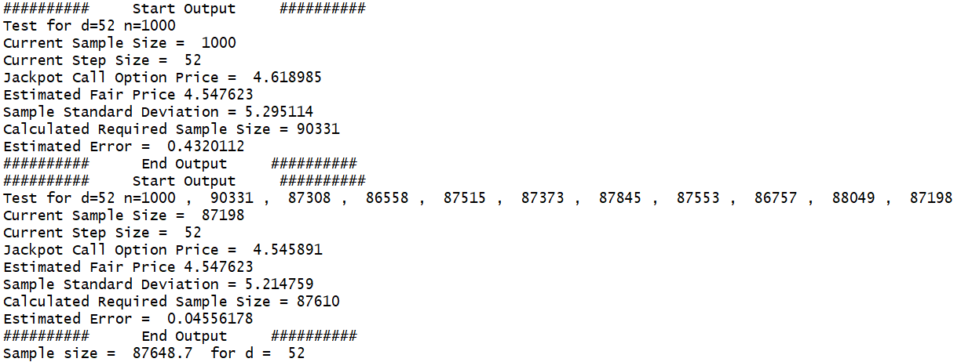

Slide 7
From the tests above for both d=12 or d=52 required size round to 88000

Slide 8
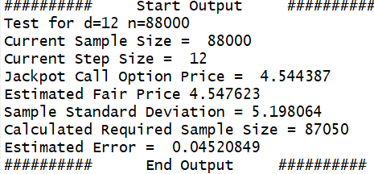
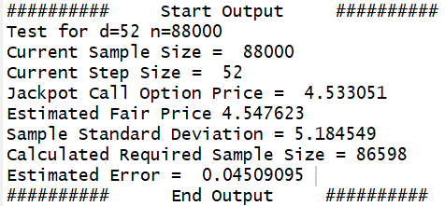

Slide 9

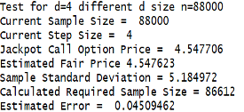
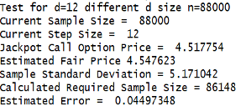
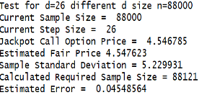
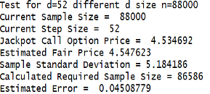
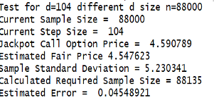
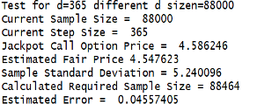

Slide 10
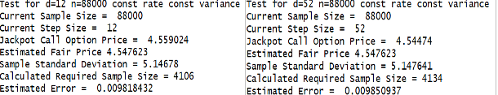

Slide 12
Computational complexity is O(n x d)
The complexity could be made more efficient if we use R each for loop
That uses parallel computing.

Slide 13
